Slide 1
Digital Portfolio
STUDENT NAME: Priya Dharshini B
REGISTER NO AND NMID: 222401256 & asunm11024ai146
DEPARTMENT: B.sc Computer Science with Artificial intelligence
COLLEGE: DRBCCC Hindu college/Madras University

Slide 2
PROJECT TITLE Digital Portfolio

Slide 3


AGENDA
Problem Statement
Project Overview
End Users
Tools and Technologies
Portfolio design and Layout
Features and Functionality
Results and Screenshots
Conclusion
Github Link
3/21/2024 Annual Review

Slide 4

PROBLEM STATEMENT Many individuals and developers need a centralized place to showcase their skills, experiences, and completed projects. The challenge lies in presenting this information in an appealing, responsive, and user-friendly format to potential employers, collaborators, or clients.

Slide 5

PROJECT OVERVIEW This portfolio website is a personal artistic showcase built for Priya Dharshini, a student and multi-talented creative (artist, calligrapher). The goal of the project is to: Present art projects with descriptive context. Share skills in an elegant layout. Enable contact through a simple, responsive form. Build a unique brand identity with personal flair.

Slide 6

WHO ARE THE END USERS? This portfolio is designed for: Art Enthusiasts who appreciate and want to explore unique crafts. Potential Clients interested in custom artwork or commissions. Recruiters or Collaborators in creative domains. Friends, family, and peers supporting Priya’s artistic journey.

Slide 7

TOOLS AND TECHNIQUES
HTML5 – For the structure and layout of the page.
JavaScript – For smooth scrolling, form handling, and basic dynamic features.
Responsive Design – Ensures optimal experience on all screen sizes.
CSS3 (Custom) – For styling with responsiveness and interactivity.
GitHub – For hosting image assets and collaboration.

Slide 8
POTFOLIO DESIGN AND LAYOUT
The layout follows a clean, mobile-first structure:
Header Navigation with links to key sections.
Profile Section with circular profile image and short bio.
Sectioned Content:
About
Projects (with artistic descriptions)
Skills
Contact Form
Footer with social/contact links and copyright.
Special Design Touches:
Soft shadows and rounded borders create a calm and friendly visual tone.
Elegant font choices and pastel backgrounds reflect artistic personality.
Hover effects and responsiveness offer a smooth UX.
8

Slide 9
FEATURES AND FUNCTIONALITY
Feature | Description
📸 Profile Section | Displays name, image, and short description.
📂 Projects | Each card highlights an art form with a thoughtful quote and link.
✅ Skills List | A flexible, badge-style layout showcasing soft and artistic skills.
✉️ Contact Form | Functional form with validation and success message using JavaScript.
📱 Responsive Design | Layout adapts beautifully to tablets and mobile devices.
🔗 Footer with Links | Direct connections to email, Instagram, and phone.

Slide 10
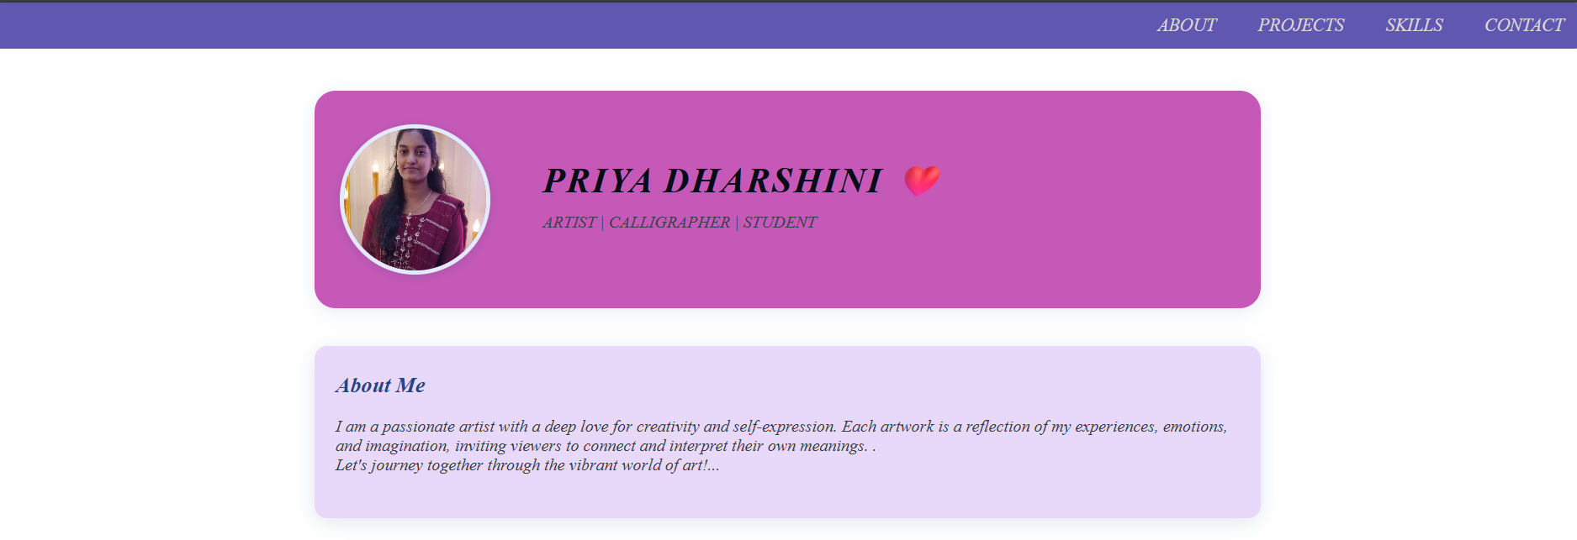
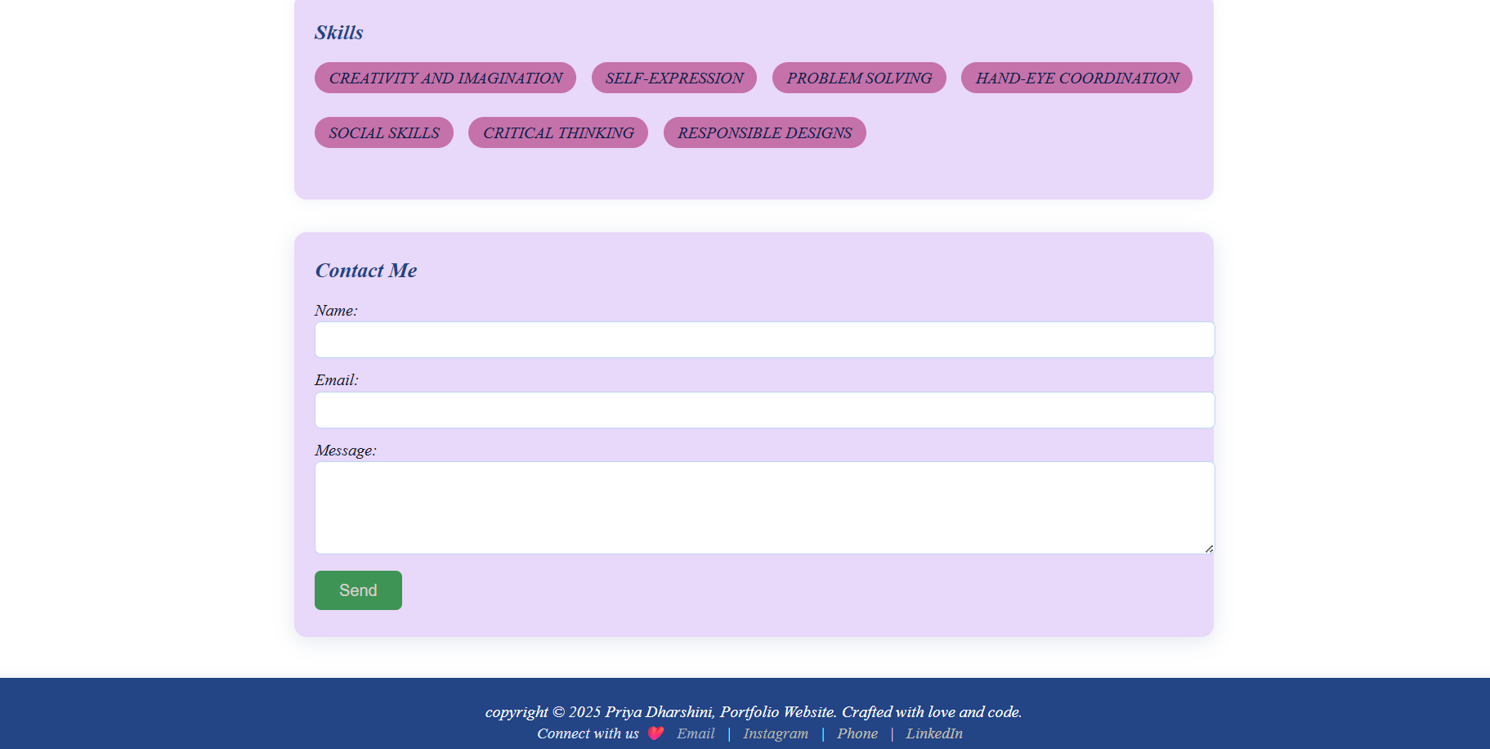
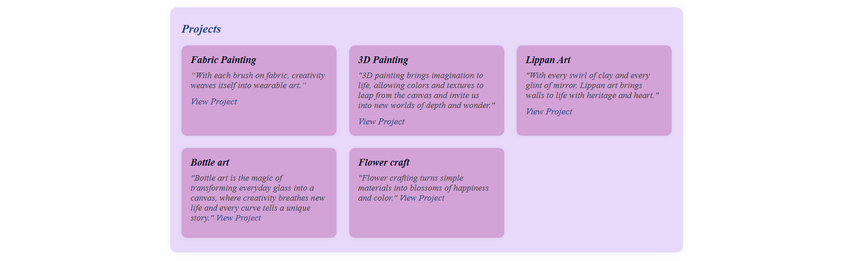
RESULTS AND SCREENSHOTS
10

Slide 11
CONCLUSION
This portfolio successfully:
Showcases creativity and uniqueness in both design and content.
Demonstrates a blend of artistic expression and basic front-end development.
Is a great foundation for further enhancements like:
Artwork galleries
Testimonial section
Blog for artistic insights or tutorials
Downloadable resume or portfolio in PDF format
11

